Slide 1
Relationships and Behaviour workshop 16th July 2021
Lucy Baker Inclusion Advisory Team (IAT)

Slide 2
Warm up

Slide 3
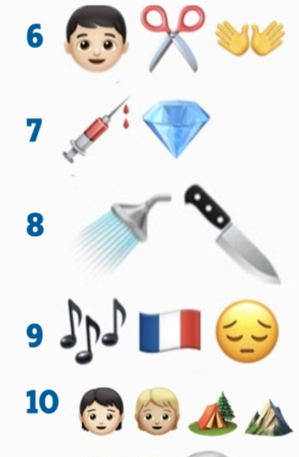
Warm up
Silence of the lambs
4 weddings and a funeral
Castaway
E.T.
Sixth Sense
Edward Scissor Hands
Blood Diamond
Psycho
Les Miserables
Brokeback Mountain

Slide 4
What is behavior?

Slide 5
From their perspective!
Defining behaviour?
Functional
It does something for them (e.g. sweat → strip; mum talking to sister in the car → hit sister)
Effective
It works for them (e.g. spelling test → crying, tantrum; scream whenever brother comes in my space or hoard things under bed)
Learnt
It is a consequence of previous experiences (e.g. ‘Can I play ball with you’ → No hide in a tunnel; hides in a cardboard box at home)
Only means for successfully influencing their environment
Communicative
Only means of communicating their need (e.g. drop to floor →time out; mum gave me the wrong spoon)

Slide 6
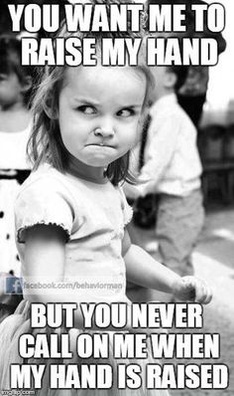

Slide 7
Every kids needs a champion!
https://www.ted.com/talks/rita_pierson_every_kid_needs_a_champion/transcript?language=en#t-107555

Slide 8
Behaviour as a form of communication

Slide 9
Behaviour as communication
Why might we see a change in behavior ?
Frustration
Fear
Hyperactivity
Attention
Discomfort
Strong feelings
Boredom

Slide 10
Why (medical)?
ADHD
Autism
Speech and language difficulties
Anxiety
Attachment Disorder
Physical disabilities
Sensory impairment

Slide 11
Triggers
Internal
External

Slide 12
What may this look like?
Low level
Medium level
High level

Slide 13
How do we create positive relationships and handle challenging behaviours…

Slide 14
Creating positive relationships
If our words don’t match our facial expressions people tend to believe the expression they see not the words they hear.

Slide 15
Creating positive relationships
7% of a message is understood from the spoken word
38% of a message is understood from the tone of voice
55% of a message is understood from facial expressions

Slide 16
Creating positive relationships
Calm
Space
Posture

Slide 17
Creating positive relationships
Choices
Time
Routines
Praise/rewards
Language
Consistence
Fun/humour

Slide 18
Managing challenging situations
Choices
Keep language simple
Consistence
Triggers/intervene quickly
Stay calm and sound confident
Reassurance/coaching
Distraction
Visuals/count down

Slide 19
6 stages of crisis

Slide 20
Case study

Slide 21
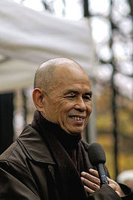
Thích Nhat Hanh (Buddhist priest)
When you plant lettuce, if it does not grow well, you don't blame the lettuce. You look into the reasons it is not doing well. It may need fertilizer, or more water, or less sun. You never blame the lettuce. Yet if we have problems with our friends or our family, we blame the other person. But if we know how to take care of them, they will grow well, like lettuce. Blaming has no positive effect at all, nor does trying to persuade using reason and arguments. That is my experience. No blame, no reasoning, no argument, just understanding. If you understand, and you show that you understand, you can love, and the situation will change.

Slide 22
Top Tips

Slide 23
Trust
Connecting and having positive relationships with the children is vital.
Make yourself interesting to the children – find their monopoly – what their special interest may be – what makes them happy and use it.
Have clear and consistent boundaries.
Give them time.
TOP TIP # 1 – develop a trusting relationship

Slide 24
Sensory
Sights, smells, sounds, touch and taste are among the senses that can be affected.
The lunch hall can be particularly difficult – sports halls are also extremely difficult.
Flashing lights or bright lights
Busy classrooms with too much on the walls can be distracting and for a person on the Autism Spectrum it can be totally absorbing or disturbing
Proprioceptive difficulties (sense of body in space) - invading others personal space
Make sure you do not stand or sit too close to your pupil
Teach them about personal space
Vestibular difficulties (balance)– seem unsteady
TOP TIP #2 - pre-warn and pre-experience

Slide 25
Communication
Make sure that your language is backed up with visuals if required.
Keep in mind the communications difficulties and differences that your child/YP may have – use lanyards or key rings with important words.
Keep your instructions clear and direct.
Be mindful of your non-verbal communication (Posture, eye contact, space, facial expressions)
Be positive and reassuring.
Offering choices
Staying calm
TOP TIP # 3 Communication is key

Slide 26
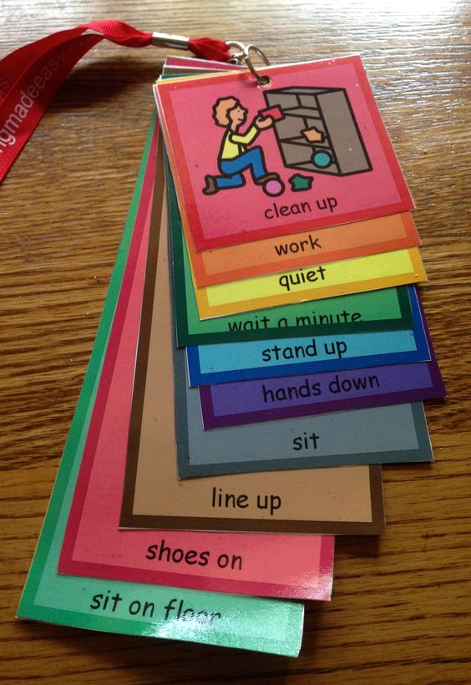
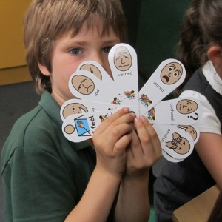

Slide 27
Routines
A routine that is predictable and positive will be your friend.
Make sure that timetables are visual and any changes are discussed before the event.
If you are not going to be in for the day make sure that this is know to your child – have a plan and key workers that can check in with your pupil.
Doing the same things all the time helps to alleviate anxiety – morning routines are especially important – going through the timetable can make your day run smoother.
Creating schedules to help predict and to help support flexibility of routine
Eliminating triggers
TOP TIP #4 : Be predictable

Slide 28
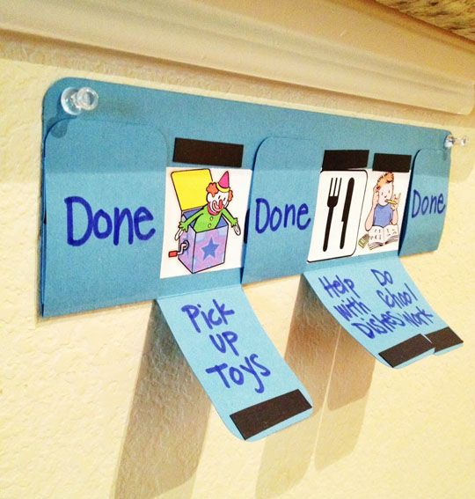
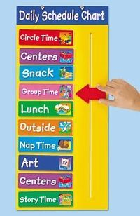
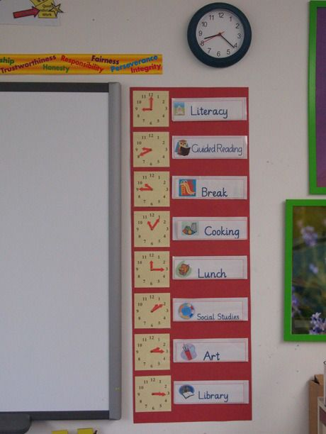

Slide 29
Be organised
Ensure activities have a clear structure – using roles in group work may help.
Point out what is relevant information.
Make sure there are plenty of visual resources to support your student.
Plan carefully.
Know your pupils strengths and plan with these in mind.
Transition object
Special job
TOP TIP #5: Treat your pupil as an individual

Slide 30
Be creative
Give the children plenty of resources to make learning meaningful.
Use visual timers for start and end of tasks.
Use their interests as a way of being interesting.
Understand what makes your pupils excited and use that to draw them in.
Make it fun!
TOP TIP #6 - Think outside the box

Slide 31
How do we adjust the soil so the flowers can grow?!

Slide 32
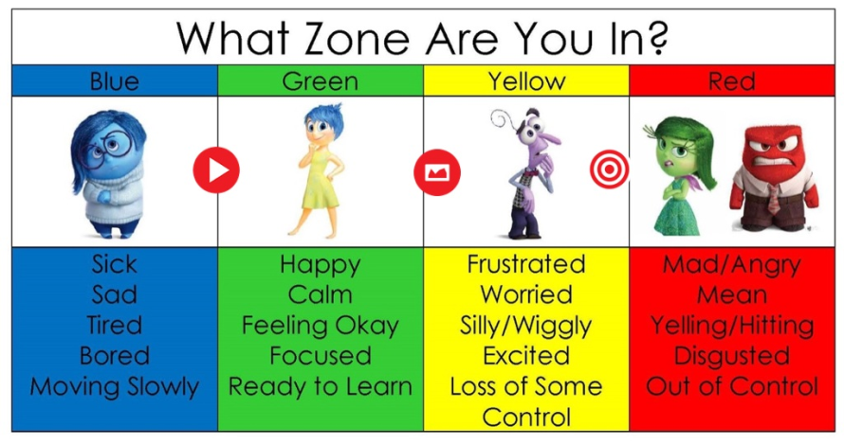
Talk emotions
Some Children/YP need help to understand, recognise and identify with emotions.
All children benefit from understanding emotions and how to regulate them.
Wandering out loud.
Validating/empathizing.
Think about using Zones of Regulation, 5 point scales or feeling walls.
TOP TIP # 7 – Teach Feelings

Slide 33
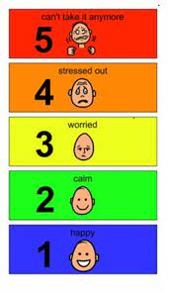

Slide 34
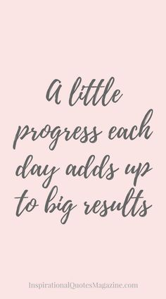
Baby steps
Making progress sometimes comes in baby steps
Keep focused on the goals
Share the progress with the family/other staff
TOP TIP #8 – Notice and rejoice in the small steps

Slide 35
Be positive
Be explicit as to what you are thinking and your expectations.
Specific praise linked to expectations.
REWARD, REWARD, REWARD – verbally, non verbally and with reward charts.
TOP TIP #9 – look for the positives

Slide 36
Think of you!
Don’t forget that your well being is vital
Take a moment to see the excellent contribution you are making.
Have some fun!!
Top Tip #10 – Take a moment for yourself

